Slide 1
Document Control

Slide 2

Accounting documents and its importance
How to open and close posting periods
What are Tolerance Groups
Importance of Terms of Payments
Cross company code transactions
Clearing process
Exchange rate differences
Course Objective

Slide 3

Course Content
DOCUMENT CONTROL
POSTING CONTROL
CLEARING PROCESS

Slide 4
Classify accounting documents
Display accounting documents
Describe the structure of accounting documents
Open and close posting periods
Open and close posting periods differently for different account types
Define the amounts that specific groups of accounting clerks are allowed to post
Assign users to a tolerance group for highest amounts
Post simple documents in Financial Accounting
Document Control
Unit Objectives:

Slide 5
Document Control: Contents
Document Structure
Posting Periods
Posting Authorizations
Simple Documents in Financial Accounting

Slide 6
Document Control: Document Structure
Document Structure
Posting Periods
Posting Authorizations
Simple Documents in Financial Accounting

Slide 7
Document Structure
Objective:
After the lesson you will be able to:
Classifying and displaying accounting documents
Structure of accounting documents
Importance of Document number ranges
Importance of Document types, Posting Keys, Field status groups

Slide 8
Documents in SAP
SAP works according to document principle. A document is saved for every posting
Every document is identified by the following:
Document number
Company code
Fiscal year
SAP system records at least one document for every business transaction with a unique document number
There can be more than one document for a business transaction
Ex: When goods arrive from a vendor (Material document and Accounting document)
There can be no accounting document generated for some business transactions
Ex: Purchase order in Material Management
Note: In a company hundreds of documents gets generated on a daily basis. To simplify the storage, documents are divided into several categories.

Slide 9
Documents in SAP
Documents in mySAP ERP Financials includes:
Document header
Information which applied to entire document
Line items (Min: 2, Max: 999)
Information which applies to individual line items
Important control keys:
Document header controlled by document type
Line items controlled by posting keys

Slide 10
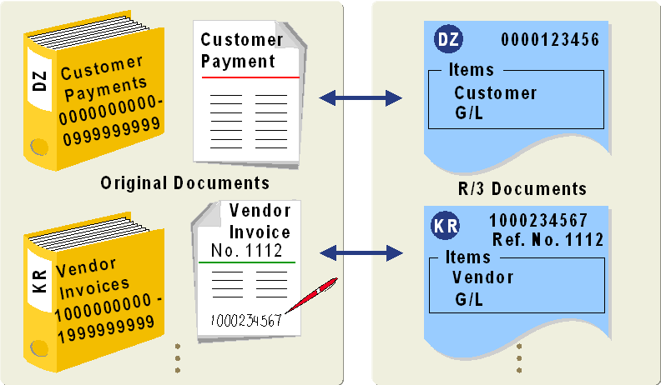
Document Types
Defined at client level
Document types controls the following:
Number ranges for document numbers
Account types permitted for postings
Field status of document header fields (Document header text and Reference number)
Whether invoices are posted with the net procedure

Slide 11
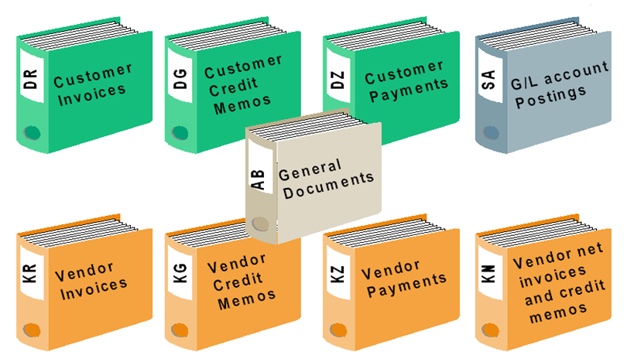
Standard Document Types
Document type “AB” allows postings to all account types
Other document types limits the accounts you can post to
Ex: DR is customer invoice, SA is G/L account postings, ZP for Automatic payments

Slide 12
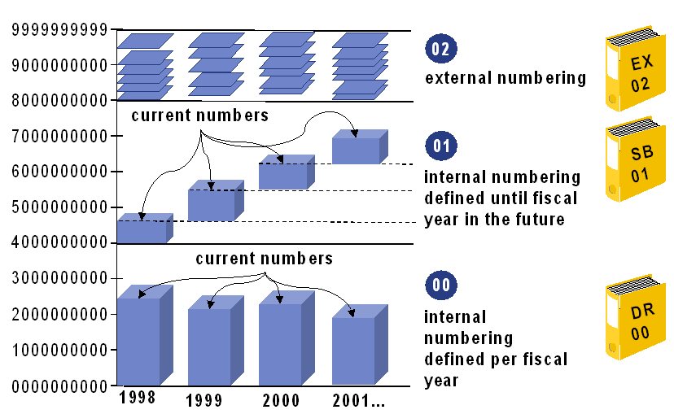
Document Number Ranges I
A document number range defines number range interval, which are assigned to document type
Number ranges must not overlap
One number range can be assigned to several document types
Number ranges intervals can be copied across company codes and/or across fiscal years

Slide 13
Document Number Ranges II
Internal number assignment:
Documents are assigned with document numbers automatically in sequence
System saves the last document number taken and issues the next number
External number assignment:
User has to manually assign the number to the document (number should be within the number range interval)
Sequential order may not be followed here, hence system does not store last document number
The numbers may be alphanumeric
Up to a fiscal year:
A number range interval is defined and it is used across all the fiscal years
At the start of new fiscal year, the number following the old number is used
For each fiscal year:
At the start of the fiscal year, the system starts again with the first number of the number range
This ensures number range is sufficient

Slide 14
Posting Keys
Defined at client level
Postings keys controls the following:
Line item can be posted to which account type
Line item is either Debit or Credit
Field status

Slide 15
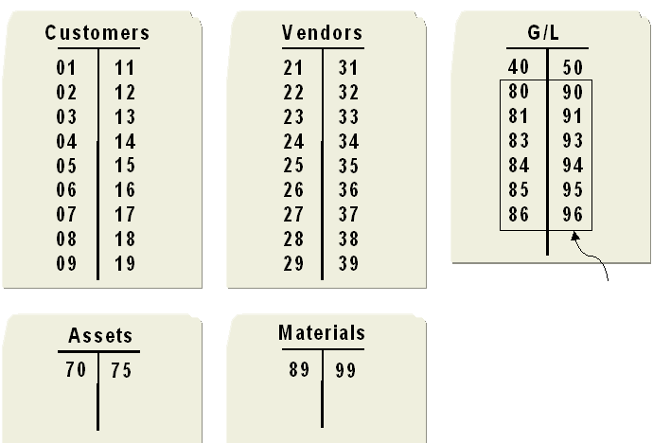
Standard Posting Keys
For G/L postings, out of
Material Management

Slide 16
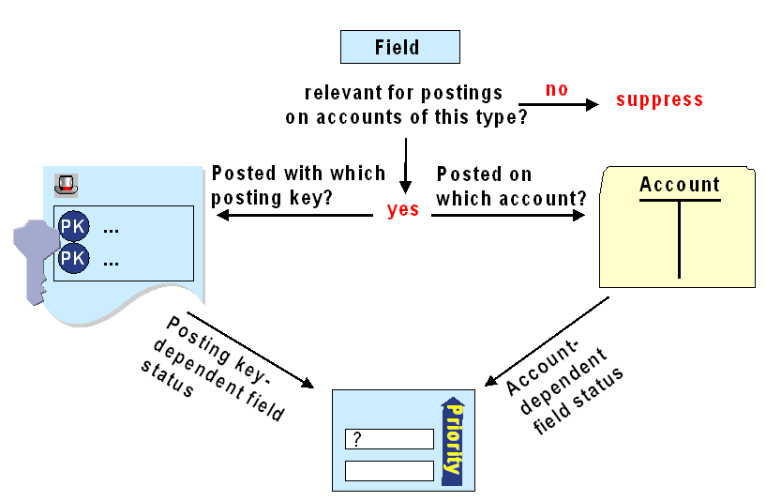
Document Field Status
During document entry, different fields are displayed depending on the transaction and the accounts used, this can be controlled by field status
Document field status controlled by
Field status of account
Posting Key
Generally, Account specific field status for G/L Accounts
Posting key field status for Customer/Vendor accounts
Field status
Hide
Required
Optional
Exceptions
Business area
Tax fields

Slide 17
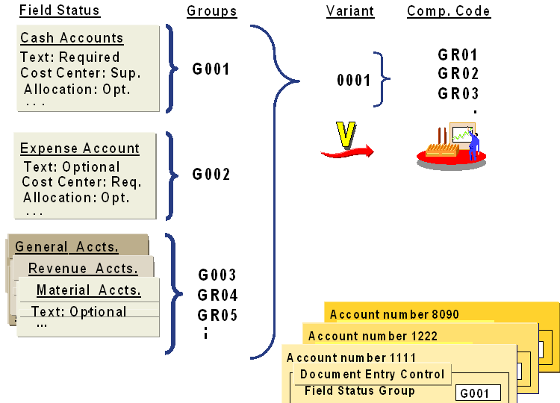
Document Field Status
Defined at client level
Documents cannot be posted until field status groups are assigned to company code

Slide 18
Document Structure
Summary:
Now you should be able to:
Understand the structure of documents in SAP
Define Posting keys, field status groups, document types

Slide 19
Document Structure: Exercise Time
? What are the most important control functions of the document type?
? If the user assigns the document number manually, this is ____ number assignment
? Document number ranges must not overlap
? What posting key controls?
? What are the two important control keys for a document?
? What controls the field status of a document?

Slide 20
Document Control: Posting Periods
Document Structure
Posting Periods
Posting Authorizations
Simple Documents in Financial Accounting

Slide 21
Posting Periods
Objective:
After the lesson you will be able to:
Open and close posting periods
Open and close posting periods differently for different account types

Slide 22
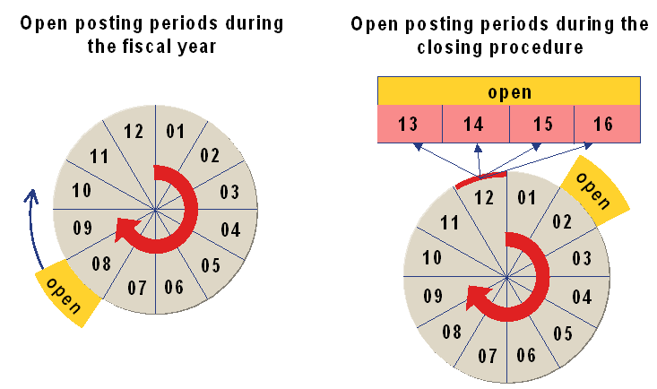
Posting Periods
Allowing users only to post in the current period, remaining periods are kept closed. At the year end special periods are open for some users for adjustment entries
Posting periods are defined in the fiscal year variant

Slide 23
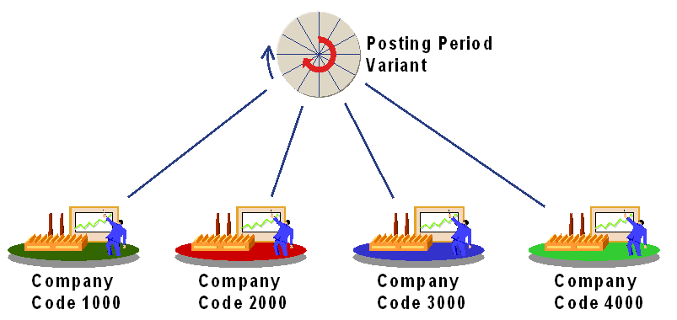
Posting Period Variant
Several company codes can use the same posting period variant
For all company codes assigned, posting periods can be open and closed simultaneously

Slide 24
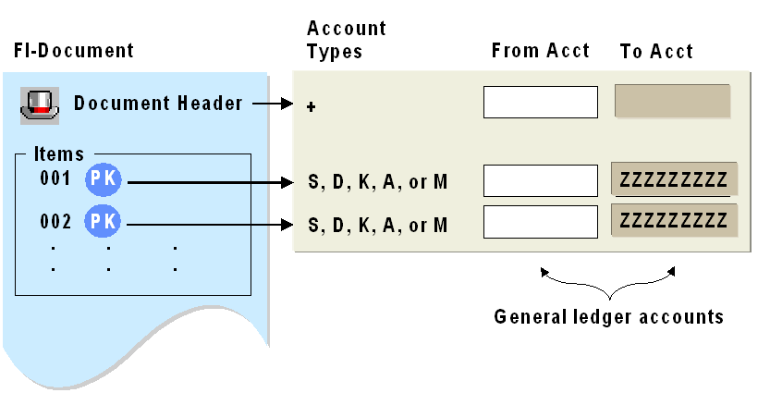
Period Checks by Account Type
S – G/L account
D – Customer
K – Vendor
A – Assets
M - Materials
In document header, period assigned to “+” is checked first. So it should be open for all account types
At line item level, system checks the account type of posting key to ensure that the period is open for assigned account type
Posting periods can be handled differently for different account types
Account interval always contains G/L accounts

Slide 25
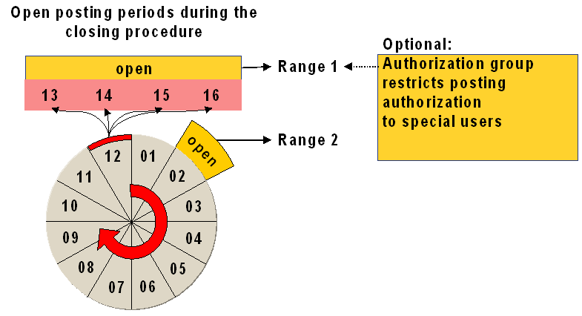
Posting Period Ranges and Authorizations
During closing two period intervals must be open at the same time for special periods
Authorization group may be assigned to the first period interval

Slide 26
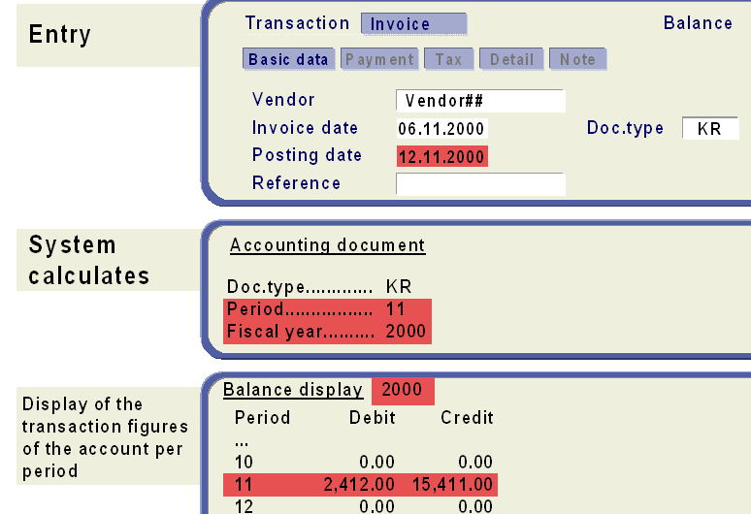
Determining the Posting Period when Posting

Slide 27
Posting Periods
Summary:
Now you should be able to:
Open and close posting periods
Open and close posting periods differently for different account types
Below embedded is the configuration for Document Type, Number Ranges and Posting Period Variant

Slide 28
Posting Periods: Exercise Time
? Only ___ symbol is enough in posting periods, to post a document.
? Number of posting periods are defined in (posting period variant/fiscal year variant).
? Maximum number of posting periods?
? Which date is considered to determine posting period? (document date, posting date, invoice date, system date)

Slide 29
Document Control: Posting Authorizations
Document Structure
Posting Periods
Posting Authorizations
Simple documents in Financial Accounting

Slide 30
Posting Authorizations
Objective:
After the lesson you will be able to:
Define the amounts that specific groups of accounting clerks are allowed to post
Assign users to a tolerance group for highest amount

Slide 31
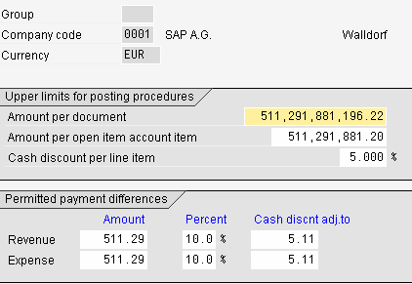
Defining Posting Authorizations
Upper Limits for posting transactions are defined in tolerance groups
In tolerance groups you can enter the upper limits for:
Total amount per document
Amount per customer/vendor item
Cash discount a user with this tolerance group is able to grant
This is also where processing of payment differences is controlled

Slide 32
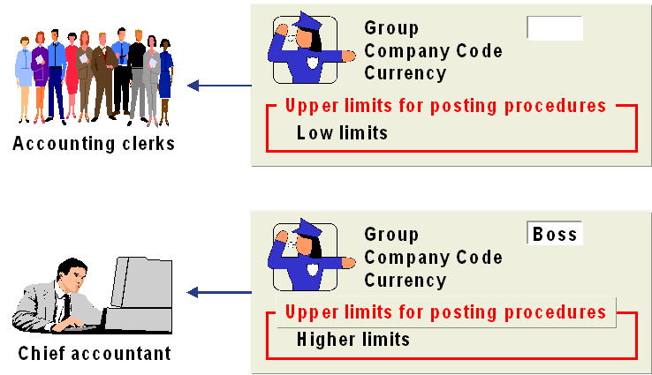
Assigning Posting Authorization
After defining the tolerance group, it has be assigned to the users
If not assigned, tolerance group “____” (blank) is valid for them, which is general tolerance group, meant for all employees
Those who have special limits, a tolerance group has to be defined and assigned to their user logon ID’s

Slide 33
Posting Authorizations
Summary:
Now you should be able to:
Define the amounts that specific groups of accounting clerks are allowed to post
Assign users to a tolerance group for highest amount

Slide 34
Posting Authorizations: Exercise Time
? Employee tolerance group controls?
? If we do not assign a name to the tolerance group defined, then?

Slide 35
Document Control: Simple Documents in FI
Document Structure
Posting Periods
Posting Authorizations
Simple Documents in Financial Accounting

Slide 36
Sample Document in Financial Accounting
Objective:
After the lesson you will be able to:
To post sample documents in Financial Accounting

Slide 37
Fiori Apps :
Post General Journal Entries
Manage Recurring Journal Entries
Reset Cleared Items
Manage Journal Entries
Totals and Balances
Document Journal
1.2.1 FTM GL Postings and Processing S/4HANA

Slide 38
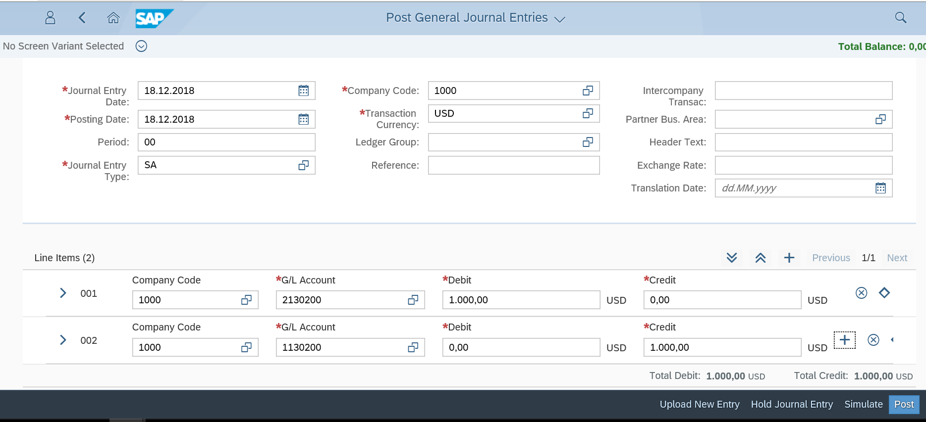
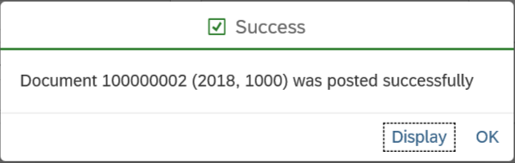
Post General Journal Entries
1. Enter Journal Entry Date
2.Enter Company Code
3.Choose/Enter the GL accounts and amounts to be posted
4.Click on Post to post the Document

Slide 39
Recurring Entries
Definition
Periodically recurring entries posted by the recurring entries program based on recurring entry documents. This process is comparable to the standing order you give to your bank to deduct your rent, premium payments, or loan repayments.
Recurring entries are business transactions that are repeated regularly, such as rent or insurance. The following data never changes in recurring entries:
Posting key
Account
Amounts
You enter this recurring data in a recurring entry original document. This document does not update the transaction figures. The recurring entry program uses it as a basis for creating accounting document
The system uses the recurring entry original document that you enter as a reference. It is not an accounting document and therefore does not affect the account balance.
In the recurring entry document, you define when a posting is to be created with this document. You have two options for scheduling. Postings can be made periodically or on a specific date.

Slide 40
Recurring Entries
For periodic postings, specify the first and last day of execution, as well as the interval in months
If you want to specify certain dates, enter a run schedule in the recurring entry original document
Recurring Document has separate number range that is “X1” to this number range we need to assign number interval to you company code.
Transaction Code: FBN1

Slide 41
Recurring Entries
In the above screen enter your company code and click on “change intervals” button.
It will display the following screen.
In the displayed screen click on it will display following window:
In the above screen we gave “X1” as number range and interval for present fiscal year
Save the activity and back to easy access screen

Slide 42
Fiori Apps :
Post General Journal Entries
Manage Recurring Journal Entries
Reset Cleared Items
Manage Journal Entries
Totals and Balances
Document Journal
1.2.1 FTM GL Postings and Processing S/4HANA

Slide 43
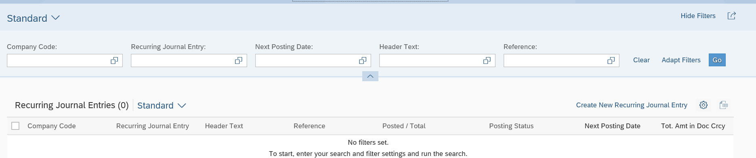
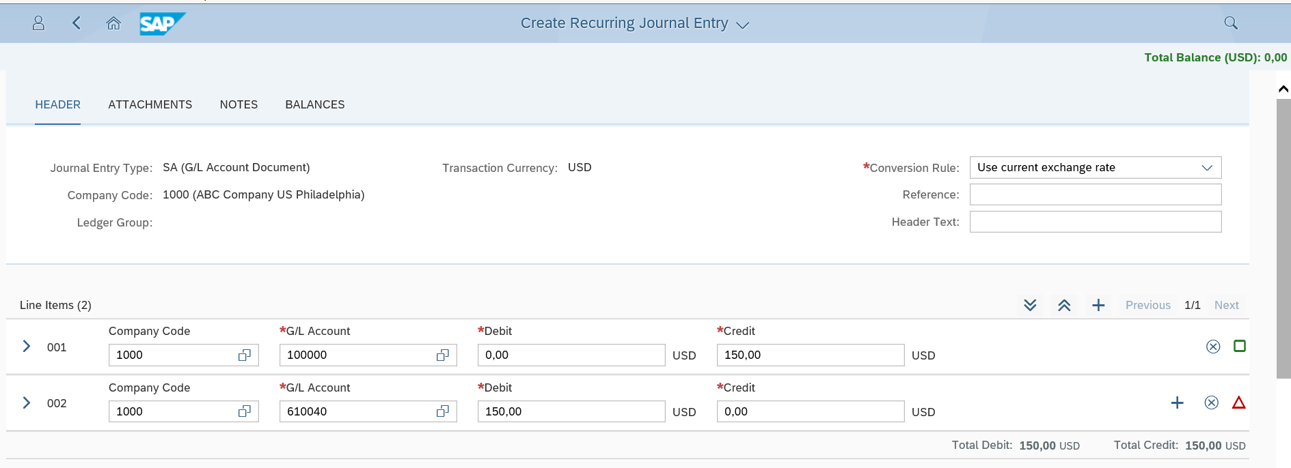
Manage Recurring Journal Entries
1.Click on Create New Recurring entries
2.Give the Document type, Company code
3.Select the GL Accounts and the Amount for the Recurring Entry

Slide 44
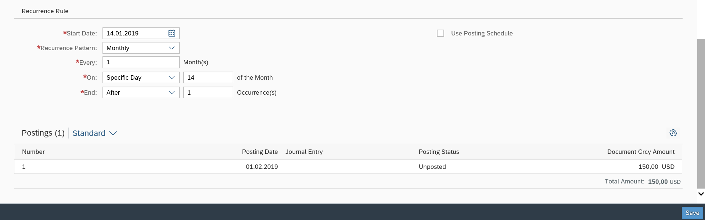
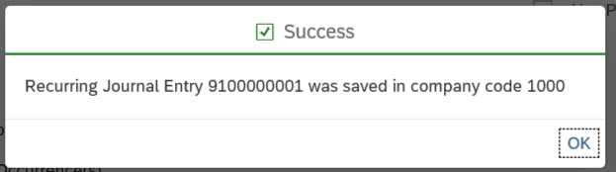
Manage Recurring Journal Entries
4.Give the start date and recurrence pattern
5.Click on Save
6.Recurring Journal Entry Created

Slide 45
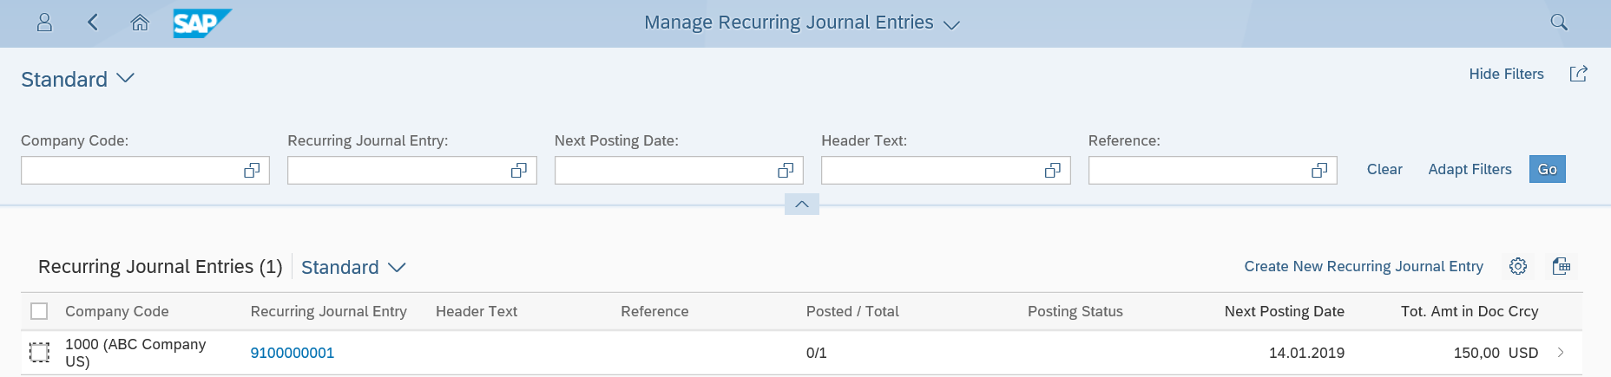
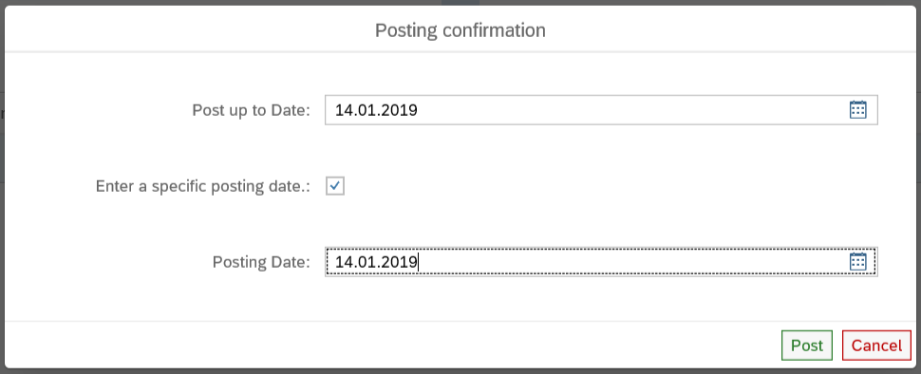
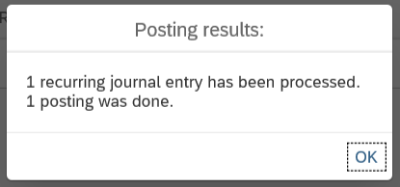
Manage Recurring Journal Entries
7.On the Manage screen choose the Recurring entry
8.Enter the Posting date
9.Click on Post
10.Recurring Journal Entry Posted

Slide 46
Posting Recurring Document
In the above screen enter values:
Company code
First run on (From which date the run schedule start)
Last run on (On which date the run schedule ends)
Interval in months
Run date (On which date the entry has to be run)
Pstky (Debit posting key)
Account (Debit G/L Account number)

Slide 47
Posting Recurring Document
In the above screen I entered amount for previous debit item, cost center (if CO is active and Cost Centers are created)
Another debit posting key and another G/L a/c number for next line item and click on enter button so it will display the following screen:

Slide 48
Posting Recurring Document
In the above screen put “*” symbol to amount field and “+” symbol to Text field and press enter button.
Now go to menu bar “Document + post” it will display the following message.
In the above message it shows the Recurring document number
Back to easy access screen.
Creation of Run Schedule
Transaction Code: OBC2
Database table: T054A
By above transaction it will display the following window:

Slide 49
Posting Recurring Document
In above window enter Run schedule and pres enter it will display the following screen in it click on
In the above screen enter the schedule dates to which you want to run the recurring document. Save the activity and back to SPRO screen.

Slide 50
Posting Recurring Document
View Recurring Document
Transaction Code: F.15
By above transaction it will display the following screen:
Fill the above parameters and click on executive button so it will display the following screen:

Slide 51
Posting Recurring Document
Execute Recurring Document
Transaction Code: F.14
By above transaction it will display the following screen:

Slide 52
Posting Recurring Document
In the above screen enter the parameters like:
Company Code
Document Number
Fiscal Year
Settlement period
Batch Input Session Name
Enter the above parameter and click on Executive button so it will display the following message.

Slide 53
Parking Document
These documents are used to enter or store incomplete documents in SAP. These documents can be complete or checked and then post at a later date. Parked document information won’t be update with any of G/L till is post again
You can park data relating to customers, vendors, G/L accounts, and asset accounts. There is an additional fast entry function for G/L accounts. For assets, you can only enter acquisitions. Furthermore, you can park tax information and special sales, but you cannot park special sales for bills of exchange or down payments
SAP provides two transactions for document parking: the standard transaction and the single screen transaction (Enjoy)
You can also check the document for completeness. For example, the system checks whether the document balance is zero and whether entries have been made in all required entry fields (such as posting key and account number)
The authorization checks performed for document parking are basically the same as those performed for standard document entry and processing. The assignment of authorizations enables the system to differentiate between users who can only park documents and those who can park and post documents

Slide 54
Parking Document
No tolerance checks are performed. The system checks for erroneous entries. For example, you cannot enter an undefined business area. You can use account assignment models when parking documents, but not reference documents.
Transaction Code: F-02
By above transaction code it will display the following screen,
In the following transaction we are trying post “Machinery Maintains exp”

Slide 55
Parking Document
In the above screen give all information as I shown
Posting key is 40 (G/L Debit) and account is Machine maintains exp G/L
Now press enter button so it will display the following screen:
In the above screen I has provided debit amount as “125000/-” and cost center but I don’t have credit information now so I am parking this entry in the middle as below:
Now go to menu bar “Document + Park” it will display the following screen:

Slide 56
Posting Parked Document

Slide 57
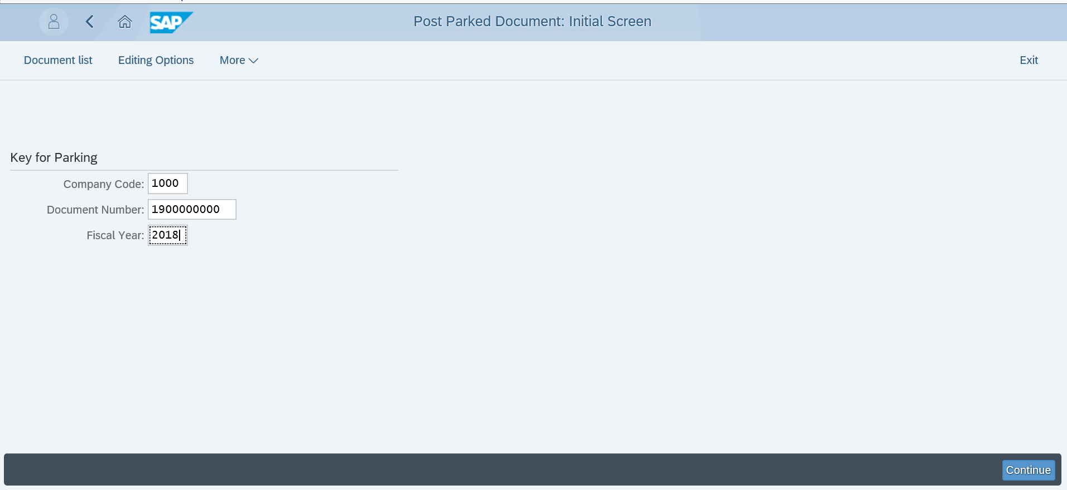
Post Parked Journal Entries
Input the Company Code, Parked Document Number, Fiscal Year
2. Click On Continue

Slide 58
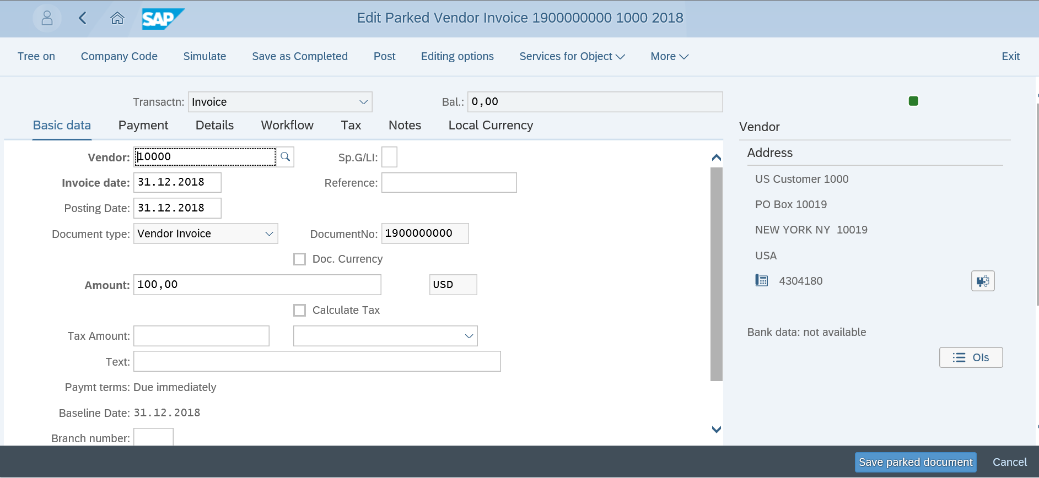
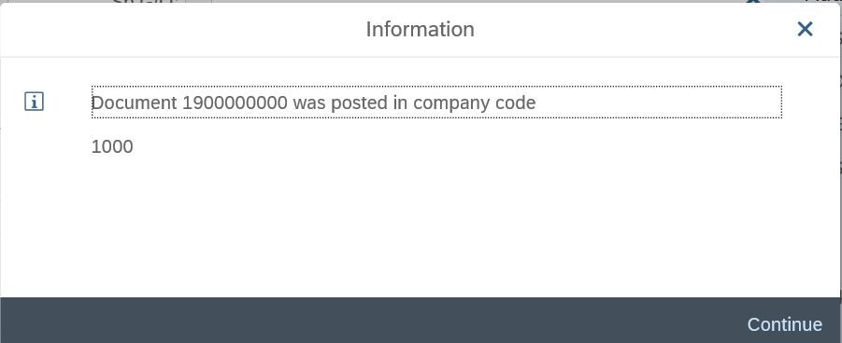
Post Parked Journal Entries
3. Click On POST
4. Parked Document Posted

Slide 59
Posting Simple FI documents: Exercise Time
Post a vendor invoice, using the following details
Company code : 1000
Date : Today’s date
Vendor : 1000
Document type : KR
G/L account : 417000
Amount : 5000
Cost center : 9030

Slide 60

Document Control
Unit Summary
Classify accounting documents
Display accounting documents
Describe the structure of accounting documents
Open and close posting periods
Open and close posting periods differently for different account types
Define the amounts that specific groups of accounting clerks are allowed to post
Assign users to a tolerance group for highest amounts
Post simple documents in Financial Accounting

Slide 61
Course Content
DOCUMENT CONTROL
POSTING CONTROL
CLEARING PROCESS

Slide 62
Define and configure user specific default values
Determine default values in the system and the configuration
Rules governing changes to documents
Analyze change documents
Reverse documents
Find reversal reasons in customizing
Define Terms of Payment
Account determination for automatic posting of cash discount
Explain and post cross-company code transactions
Posting Control
Unit Objectives:

Slide 63
Posting Control: Contents
Default Values
Change Control
Document Reversal
Payment Terms and Cash Discounts
Cross-company Code Transactions

Slide 64
Posting Control: Default Values
Default Values
Change Control
Document Reversal
Payment Terms and Cash Discounts
Cross-company Code Transactions

Slide 65
Default Values
Objective:
After the lesson you will be able to:
Define default values
Configure user-specific default values
Determine default values in the system and the configuration

Slide 66
Default Values
Instead of re-entering the data whenever you post, you can define certain default values in the system. Those values will be defaulted whenever you start a transaction.
You can enter default values in the following:
User master record
Parameter memory
System data
Account master record
Accounting functions
Using Editing options (T code: FB00) you can configure your screens for the following areas:
Document entry
Document display
Open items

Slide 67
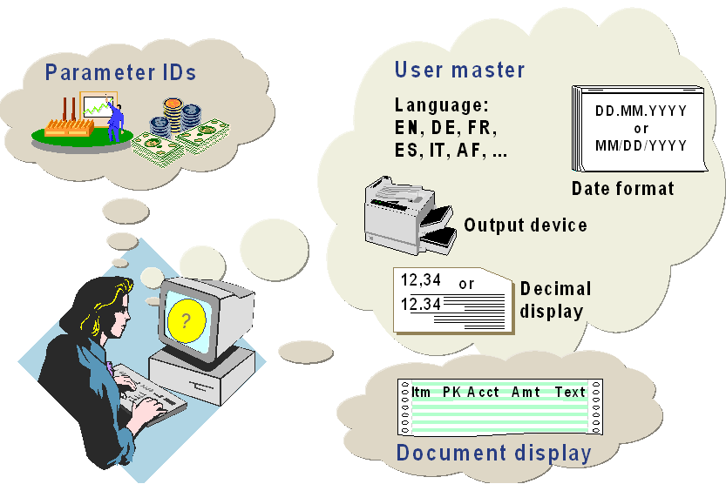
Parameter ID and User ID
In Parameter IDs you can set default company code, currency etc.
In user’s master data date, language, printers etc. can be defaulted.
On the menu bar follow the path System – User profile – Own data,

Slide 68
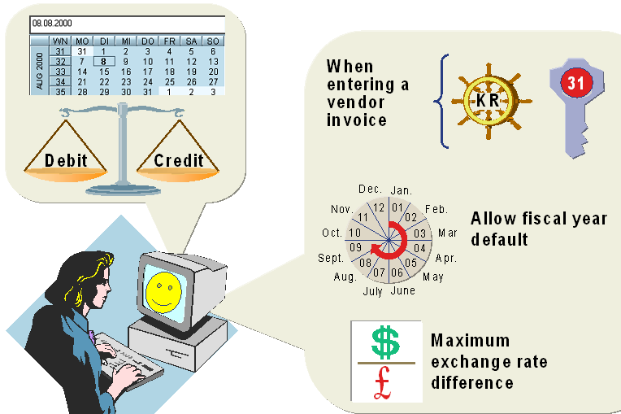
Some Default Values
System data:
Basic default values such as current date is proposed as posting date
Once you create a document, for the next document system proposes the same company code
Account master record:
Default values for customer/vendor. Ex: Posting key, document type etc.
Accounting functions:
Debit total and credit totals should match

Slide 69
Default Values
Summary:
Now you should be able to:
Explain the sources of default values
Define and configure default values

Slide 70
Default Values: Exercise Time
? List some sources of values that are defaulted by the system for document entry.
? Go to your respective user profile and default the date format/decimal notation.

Slide 71
Posting Control: Change Control
Default Values
Change Control
Document Reversal
Payment Terms and Cash Discounts
Cross-company Code Transactions

Slide 72
Change Control
Objective:
After the lesson you will be able to:
Explain rules governing changes to documents
Change documents
Analyze changes to documents

Slide 73
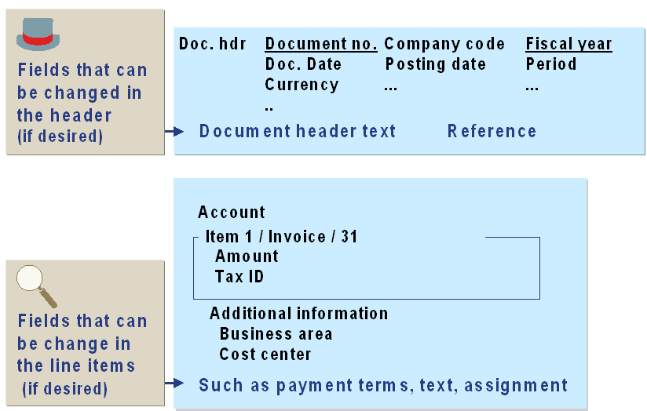
Change Control
In general once the document is posted it is not possible to delete it, instead a rectification entry or reversal entry is made to rectify (if there is an error).
SAP Financials also does not allow to delete the document. However, based on different rules, only certain fields can be changed.
System does not permit changes to the fields which effects the reconciliation of the posting.

Slide 74
Change Rules
As user make changes the following information is logged:
The field that was changed
The new and old values
The user who made the changes
The time and date of the change
Different document change rules based on:
Account type: A, D, K, M, S
Special G/L transactions: Down payment, down payment requests, BOE etc.
Company code
Prerequisites for field changes:
Posting period open
Line item not cleared
Posting as debit/posting as credit
No invoice-related credit memo
No credit memo from down payment

Slide 75
Change Control
Summary:
Now you should be able to:
Explain the rules governing changes to document
Change documents
Analyze changes to document

Slide 76
Change Control: Exercise Time
? After you post a document, name the fields you can change.
? Whether an additional account assignment (cost center/business area) can be changed after posting a document?

Slide 77
Posting Control: Document Reversal
Default Values
Change Control
Document Reversal
Payment Terms and Cash Discounts
Cross-company Code Transactions

Slide 78
Document Reversal
Objective:
After the lesson you will be able to:
Reverse documents
Types of reversals
Reversal reasons

Slide 79
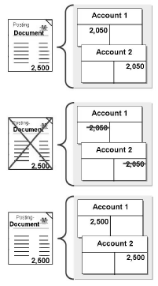
Document Reversal
As discussed earlier, documents cannot be deleted but can be reversed.
Document entered incorrectly
System provides function to reverse G/L, customer, vendor documents both individually or in a mass reversal.
Document corrected by Reversal
Document re-entered correctly

Slide 80

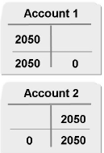
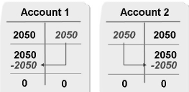
Types of Reversals
Document can be reversed by:
Normal reversal posting
Negative posting
Normal reversal posting:
Incorrect debit as credit and vice versa
Increase in transaction figures
Negative posting:
Incorrect debit as credit and vice versa
Posted amount not added to transaction figures, but subtracted from transaction figures
This makes the balance reduced as it is before the incorrect posting
Normal Reversal
Incorrect Posting
Negative Reversal
Transaction Figures

Slide 81
Reversal Reason
Whenever you reverse a document, you have to enter a reversal reason that explains the reversal
Reversal reason also controls whether the reversal date is allowed to be different to the original posting date
Documents with cleared items cannot be reversed. It must be reset.
To activate negative postings:
The company code should permit negative postings. [T.code – (OBY6)]
Reversal reason must be defined for negative reversal

Slide 82
Document Reversal
Summary:
Now you should be able to:
Understand the types of reversals
Reverse the documents
Explain reversal reason codes

Slide 83
Document Reversal: Exercise Time
? Name the two possible ways to reverse a document in mySAP ERP Financials.
? What are the two prerequisites that must be fulfilled in order to process negative postings?
? Check whether company code “1000” allows negative postings.
? Cleared documents can be reversed (T/F)

Slide 84
Posting Control: Payment Terms and Cash Discounts
Default Values
Change Control
Document Reversal
Payment Terms and Cash Discounts
Cross-company Code Transactions

Slide 85
Payment Terms and Cash Discounts
Objective:
After the lesson you will be able to:
Define terms of payment
Explain the account determination for automatic postings of cash discount

Slide 86
Terms of Payment
Terms of payment are conditions agreed between business partners for the payment of invoices. It defines the due date and the cash discount offered for payment of the invoice within a certain period
The company uses different terms of payment for customers and vendors
It continually negotiates new terms of payments with a vendor, and these are to be reflected in the system
The terms of payment are used to define:
Baseline date for due date calculation
Cash discount periods
Cash discount percentage rates
The terms of payment are:
Assigned to customer/vendor master record
Defaulted by the system or entered by the user
Used in transaction line items to determine payment conditions

Slide 87
Terms of Payment in Invoices
You can enter terms of payment in:
Customer master
Company code segment
Sales area segment
Vendor master
Company code segment
Purchasing organization segment
Terms of payment in invoice is copied from:
Company code segment | Invoice created in Financials
Sales area segment | Invoice created in SD
Purchasing organization segment | Invoice created in MM

Slide 88
Terms of Payment in Credit Memos
Invoice related credit memos:
Credit memos can be linked to the original invoice by entering the invoice number in the "Invoice Reference" field during document entry. In this case, the terms of payment are copied from the invoice so that the invoice and the credit memo are due on the same date.
Other credit memos:
Terms of payment in other credit memos are invalid. These credit memos are due on the baseline date. To activate the payment terms on these non-invoice related credit memos, enter a “V” in the "Invoice Reference" field when entering the document.

Slide 89

Terms of Payment - Basics
Day limit Payment terms 0009 Payment terms 0009
Day limit 15 Day limit 31
Description:
With a 15 day limit: 2% cash discount until the 15th of the next month. Until the end of the following month without a discount.
With a 31 day limit: 2% cash discount until the end of the next month. Until 15th of the second month without a discount.
Two types of descriptions: 1. Automatically generated
2. SD text for printing on invoices
Account type: Customer Vendor
Click me for
SAP SCREEN

Slide 90


Terms of Payments: Payment Controls
Using Block keys, which can be entered in line items or accounts, you can block line items or accounts for payment or collection. These block keys can also be entered in payment terms.
A payment method (for each country, the system has payment methods defined that you can use in that country) is entered in the line items or the accounts. Like payment blocks, payment methods can be entered in the terms of payment.
Click me for
SAP SCREEN

Slide 91
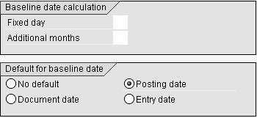
Baseline Date
The baseline date is the starting date the system uses to calculate the invoice due date.
Fixed day used to overwrite the calendar day of the baseline date.
The number of month(s) to be added to the calendar month of the baseline month.
Click me for
SAP SCREEN

Slide 92
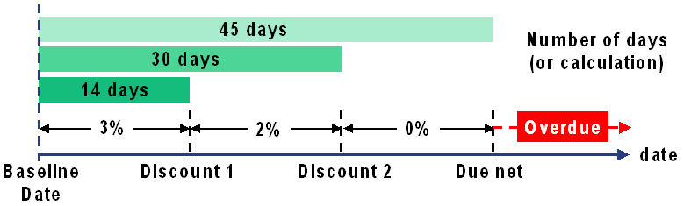
Cash Discount Calculation
You can enter up to three cash discount periods
The days and months specified in the terms of payment are used in conjunction with the baseline date to calculate the correct cash discount amount for the payment date
Click me for
SAP SCREEN

Slide 93
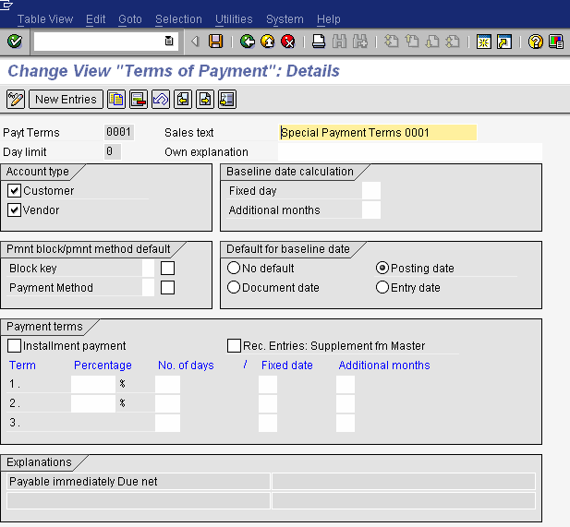

Slide 94
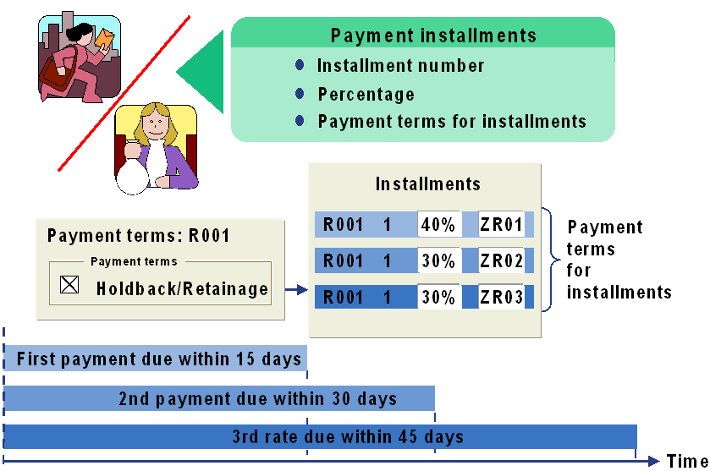
Installments
System creates line items for each installment
The terms of payment for the line items are the terms of payment defined for the individual installments
Click me for
SAP SCREEN

Slide 95
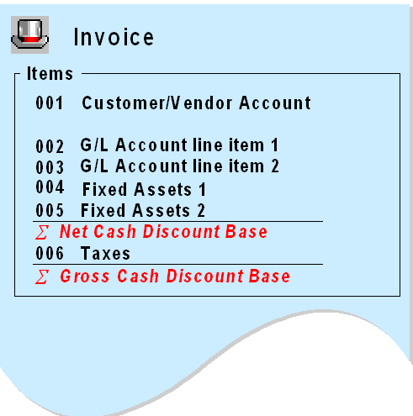
Cash Discount Base Amount
Cash discount base amount can be either net value (excluding taxes) or gross value (including taxes). It is defined in global parameters of company code (OBY6).

Slide 96
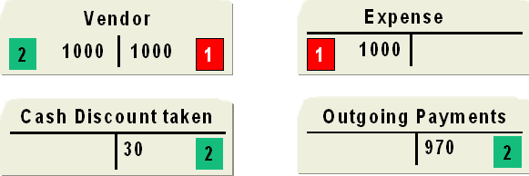


Posting Cash Discount – Gross Procedure
Accounts Payable
Invoice
Clearing
Assuming no tax
Invoice
Posted with document type KR
Observe that cash discount G/L account appeared at the time of clearing

Slide 97
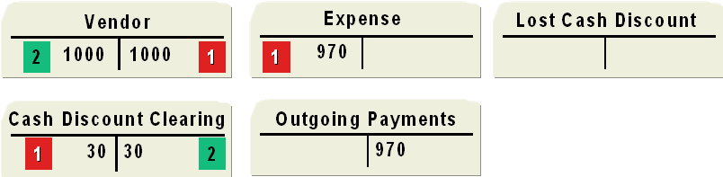
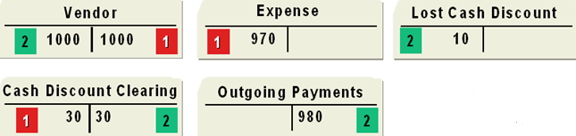
Posting Cash Discount – Net Procedure
Paying within the cash discount period
Invoice
Clearing
Paying after cash discount deadline
Assuming no tax
Invoice
Posted with document type KR
Observe that cash discount G/L account appeared at the time of Invoice

Slide 98
Payment Terms & Cash Discounts
Summary:
Now you should be able to:
Define terms of payments
Understand the importance of Baseline date, Day limits
Configure installment payments
Post cash discount using gross procedure/net procedure

Slide 99
Payment Terms & Cash Discounts: Exercise Time
? Create a new terms of payment key for vendor
5% for immediately payment
2% cash discount for payment within 14 days
No deduction for payment in 30 days
The posting date is the baseline date
? Every installment of an installment plan must have its own terms of payment. (T/F)
? The is the date that the system uses to determine the due date of the invoice?
? Posting cash discount Gross procedure Vs Net procedure.
? What are the defaults for baseline date.
? TOP can be used for both customer and vendor (T/F)

Slide 100
Posting Control: Cross-company Code Transactions
Default Values
Change Control
Document Reversal
Payment Terms and Cash Discounts
Cross-company Code Transactions

Slide 101
Cross-company Code Transactions
Objective:
After the lesson you will be able to:
Explain cross-company code transactions
Post cross-company code transactions

Slide 102
Cross-company Code Transactions
A cross-company code transaction involves two or more company codes in one business transaction
Examples:
One company code makes purchases for other company codes (Central Procurement)
One company code pays invoices for other company codes (Central Payment)
One company code sells goods to other company codes
A cross-company code transaction posts to accounts in several company codes
Separate document in each company code
One common document is generated linking all documents in each company code, called “Cross-company code transaction number”

Slide 103
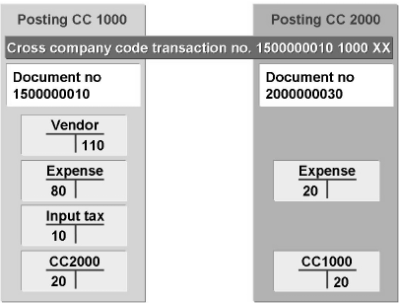
Example …
Tax is not distributed between company codes
Clearing postings are made automatically, hence clearing accounts has to be defined in every company code before a cross-company code transaction may be carried out

Slide 104
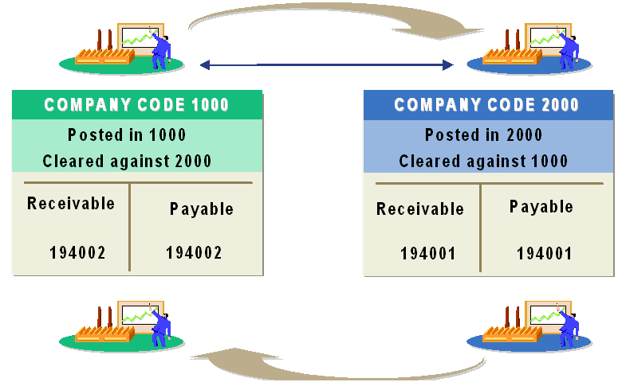
Clearing Accounts
In order to balance debits and credits within these documents, the system generates automatic line items which are posted to clearing accounts
In the configuration you must assign clearing accounts to every possible combination of two company codes to allow cross-company code postings between these combinations
Clearing accounts can be G/L, Customer or Vendor accounts

Slide 105
Cross Company Code Document Number
Cross company code document number
=
Document number of first company code + First company code + Fiscal year
It is stored in the document header of all of the documents created

Slide 106
Cross-company Code Transactions
Summary:
Now you should be able to:
Explain cross-company code transactions
Post cross-company code transactions

Slide 107
Cross-company Code Transactions: Exercise Time
? Some examples of cross-company code transactions.
? Cross company code document number is a combination of_____. And it is stored at?
? Clearing accounts are only G/L accounts. (T/F).
? T.code for using cross-company transactions?

Slide 108
Posting Control
Unit Summary
Define default values
Configure user-specific default values
Determine default values in the system and the configuration
Explain the rules governing changes to documents
Change documents
Analyze changes to documents
Reverse documents
Find reversal reasons in Customizing
Define terms of payment
Explain the account determination for automatic postings of cash discount
Explain cross-company code transactions
Post cross-company code transactions

Slide 109
Course Content
DOCUMENT CONTROL
POSTING CONTROL
CLEARING PROCESS

Slide 110
Explain the clearing process
Clear an account
Post with clearing
Post incoming and outgoing payments
Reset clearing
Post payment differences
Describe tolerance groups and their role for posting payment differences
Post partial and residual payments
Create and use payment difference reason codes
Explain the system treatment of exchange rate differences
Clearing Process
Unit Objectives:

Slide 111
Clearing Process: Contents
Clearing Open Items
Incoming and Outgoing Payments
Payment Differences
Exchange Rate Differences

Slide 112
Clearing Process: Clearing Open Items
Clearing Open Items
Incoming and Outgoing Payments
Payment Differences
Exchange Rate Differences

Slide 113
Clearing Open Items
Objective:
After the lesson you will be able to:
Explain the clearing process
Clear an account
Post with clearing

Slide 114
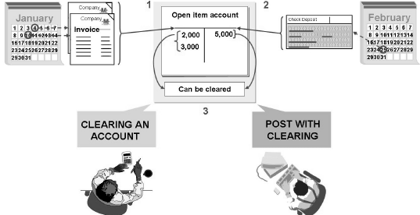
Clearing Open Items
Open items are incomplete transactions, such as invoices that have not been paid
Documents cannot be archived until they are cleared
Types of clearing in SAP Financials:
Post with clearing
Account clearing
A clearing transaction always creates a clearing document

Slide 115
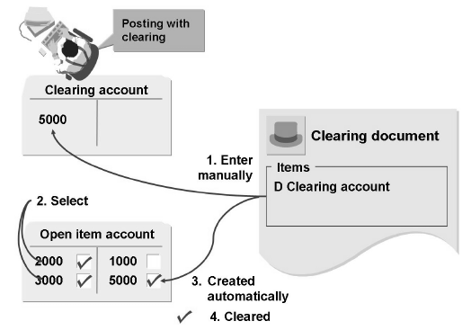
Post with Clearing
When you use the "posting with clearing" function, enter the clearing document amount and then select the open items that are to be cleared
If clearing amount equals selected open items amount system clears it
If there is any difference system allows to post the difference
Post with clearing can be done either manually or by Automatic Payment Program

Slide 116
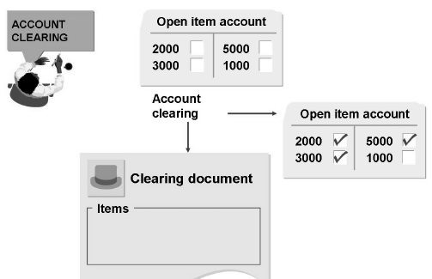
Account Clearing
Using the account “clearing function”, choose those open items from an account that balance to zero. The system marks them as cleared and creates a clearing document
Account clearing function works for any account managed with open items in the general ledger and in sub ledgers
Account clearing can be done either manually or by Automatic Clearing Program

Slide 117
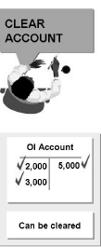
Automatic Clearing Program
Steps in the clearing program
Group items for each account
If balance is zero, items are marked for clearing
Prerequisites for clearing
User criteria must be defined in customizing
Accounts to be cleared must be defined for automatic clearing
Items that are not cleared
Noted Items
Statistical postings, bill of exchange postings
Items with withholding tax entries

Slide 118
Clearing Open Items
Summary:
Now you should be able to:
Explain the clearing process
Clear an account
Post with clearing

Slide 119
Clearing Open Items: Exercise Time
? What are the types of clearing?
? What is the difference between Automatic clearing program and Automatic payment program.
? Items that are not cleared by automatic clearing program.

Slide 120
Clearing Process: Incoming and Outgoing Payments
Clearing Open Items
Incoming and Outgoing Payments
Payment Differences
Exchange Rate Differences

Slide 121
Clearing Open Items
Objective:
After the lesson you will be able to:
Post incoming and outgoing payments
Reset clearing

Slide 122
Manual Payment Process
A manual payment is a transaction that clears an open item, typically an invoice, by manually assigning a clearing document
An incoming payment, typically used in Accounts Receivable, clears an open debit amount
An outgoing payment, typically used in Accounts Payable, clears an open credit amount
A manual payment is processed in three steps:
Data is entered in the document header
Open items are selected to be cleared
The transaction is saved

Slide 123
Document Header
Document header consists of three sections:
Payment header
Bank data
Open item selection
Important fields need to be filled in payment header are company code, dates, document type (defaulted) etc.
Important fields in Bank data are Bank/cash Account number, amount, value date etc.
Fields in open item selection customer/vendor account, account type (K,D)
For selecting the open items there are certain features like
Distribute by age (items according to days in arrears)
Automatic search (shows the OI’s which matches the data filled above)
Can make additional selections for selecting open items
Special G/L’s can also be cleared
Click me to view
SAP SCREEN

Slide 124
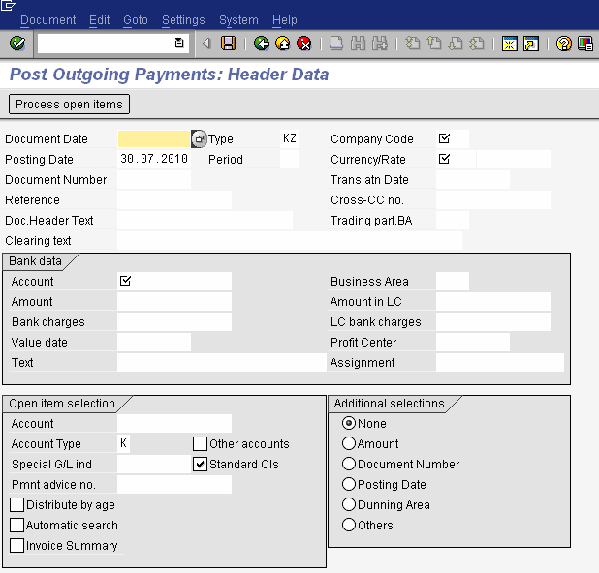

Slide 125
Processing Open Items
Select the process open items after entering data in document header
Select the required open items
You can post the document if the amount entered is the same as the amount assigned
You can directly save the document, or can simulate to view automatically generated line items also can correct mistakes done
Posting difference are shown in coming slides.
Click me to view
SAP SCREEN

Slide 126
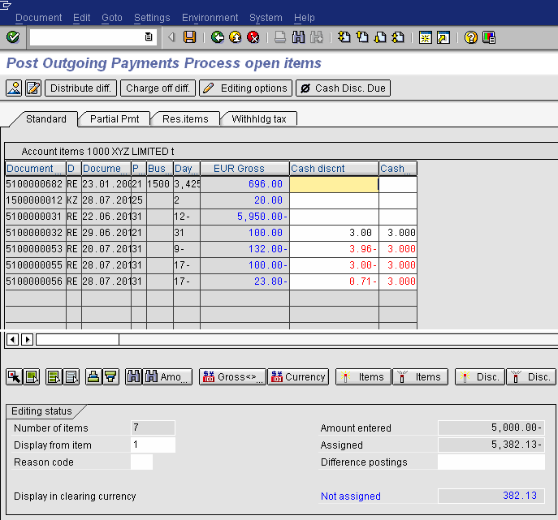

Slide 127
Automatic Postings when Clearing Open Items
Cash discount expense or revenue
Cash discount clearing (net procedure)
Tax adjustments
Exchange rate differences
Bank charges
Clearing for cross-company code payments
Over-or under payments within tolerances

Slide 128
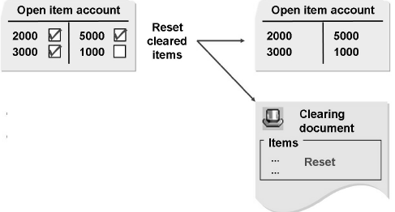
Reset Clearing
When line items are cleared with error, cancel clearing by resetting clearing document and cleared items
After reset the cleared items will become open items as like earlier
On Easy Access: Accounting – financial accounting – General ledger – Document – Reset cleared items (FBRA)

Slide 129
Incoming and Outgoing Payments
Summary:
Now you should be able to:
Post incoming and outgoing payments
Reset clearing

Slide 130
Incoming and Outgoing Payments: Exercise Time
? What are the automatic postings when clearing a open item.
? Clear the invoice which is posted in company code 1000.
? What is reset clearing?

Slide 131
Clearing Process: Payment Differences
Clearing Open Items
Incoming and Outgoing Payments
Payment Differences
Exchange Rate Differences

Slide 132
Payment Differences
Objective:
After the lesson you will be able to:
Post payment differences
Describe tolerance groups and their role for posting payment differences
Post partial and residual payments
Create and use payment difference reason codes

Slide 133
Tolerance Groups
Customers often pay invoices with deductions that sometimes exceed the tolerance limits of the company
In accounting there are three types of tolerances:
Employee tolerance group: (refer authorizations lesson slides)
Upper limits for posting transactions
Permitted payment differences
G/L account tolerance group:
Permitted payment differences (ex: automatic clearing procedures)
Customer/vendor tolerance groups:
Permitted payment differences
Clearing transactions
Posting residual items from payment differences
Tolerances for payment advice notes
Click me to view SAP SCREEN
Click me view
SAP SCREEN
Click me view SAP SCREEN

Slide 134
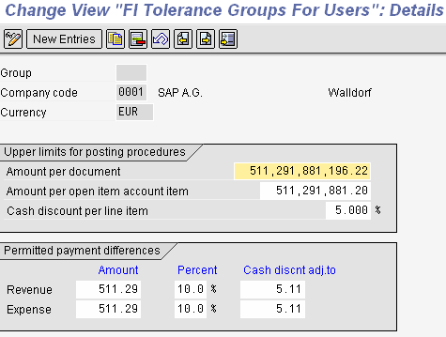

Slide 135
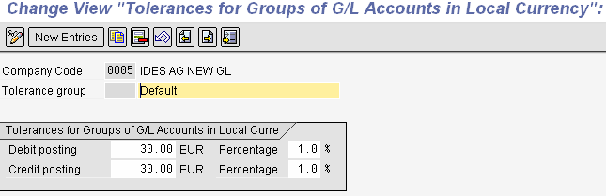

Slide 136


Slide 137

Permitted Payment Differences
Consider an example of Customer invoice. At the time of clearing the least of employee tolerance and customer tolerance group is considered by the system
They control the automatic posting of cash discount adjustments and unauthorized customer deductions

Slide 138

Example on Payment Difference
Considering the below example:
If the difference in payment is within the tolerance of cash discount it is adjusted to cash discount account
If difference exceeds cash discount adjustment and within unauthorized tolerance limit then adjusted to unauthorized customer deductions
If difference exceeds unauthorized tolerance limit then it has to be processed manually

Slide 139
Processing Payment Differences
Processing
payment differences
Within defined
tolerances
Outside of
tolerances
Automatic
cash discount
adjustment
Manual
cash discount
adjustment
Partial
payment
Residual
items
Automatic
Posting of
unauthorized
deductions
Clear
Difference
manually
Payment on
account

Slide 140


Manually Processing – Outside Tolerance Limits
Partial payment:
Both items remain as open items
Partial payment
Residual items:
Payment amount and invoice are cleared and new item gets generated with remaining amount
TOP (from cleared item/new TOP)
Residual item
Payment differences:
Post the payment difference to a different account as a difference posting using reason codes and automatic determination
Payment differences

Slide 141

Reason Codes
Reason codes are used to describe the reason for the payment difference
To assign more than one reason code to a payment difference, click on “distribute difference”
Reason codes can be assigned to:
Difference postings
Partial payments
Residual items

Slide 142
Payment Differences: Summary
Summary:
Now you should be able to:
Post payment differences
Describe tolerance groups and their role for posting payment differences
Post partial and residual payments
Create and use payment difference reason codes

Slide 143
Payment Differences: Exercise Time
? A ____clears the invoice and the payment to create a new open item.
? What are the types of tolerances in SAP Financials?
? When clearing a customer invoice which tolerances are considered?
? When customer payment exceeds the limit of unauthorized deductions then what is the treatment?
? When partial payment’s done by customer, invoice and payment documents gets cleared. (T/F)
? What is the importance of reason codes?

Slide 144
Clearing Process: Exchange Rate Differences
Clearing Open Items
Incoming and Outgoing Payments
Payment Differences
Exchange Rate Differences

Slide 145
Exchange Rate Differences
Objective:
After the lesson you will be able to:
Understand exchange rate differences
Explain the system treatment of exchange rate differences

Slide 146

Realized Exchange Rate Differences
When clearing open items in a foreign currency, exchange rate differences may occur due to fluctuations in exchange rates
The system posts these exchange rate differences automatically as realized gains or losses
The system posts the differences automatically to the revenue/expense account for exchange rate differences that you defined during configuration
The realized difference is stored in the cleared line item

Slide 147

Account Determination
All reconciliation accounts and all G/L accounts with open item transactions in foreign currency must be assigned revenue/expense accounts for realized losses and gains.
One gain/loss account can be assigned:
To all currencies and currency types
Per currencies and currency type
Per currency
Per currency type

Slide 148
Unrealized Exchange Rate Differences
Exchange rate differences are also posted when open items are valuated for the financial statements
These exchange rate differences from valuation are posted to another exchange rate difference account (unrealized loss/gain) and to a financial statement adjustment account
When clearing an open item that has already been valuated, the system reverses the balance sheet correction account and posts the remaining exchange rate difference to the account for realized exchange rate differences

Slide 149
Exchange Rate Differences: Summary
Summary:
Now you should be able to:
Understand exchange rate differences
Explain the system treatment of exchange rate differences

Slide 150
Exchange Rate Differences: Exercise Time
? Exchange rate differences at the time of clearing an open item (Realized gain/loss or Unrealized gain/loss)
? Exchange rate differences at the time of Valuating the open items (Realized gain/loss or Unrealized gain/loss).
? Realized difference is not stored in the line item (T/F).
? System post the differences automatically (T/F).

Slide 151
Clearing Process
Unit Summary
Explain the clearing process
Clear an account
Post with clearing
Post incoming and outgoing payments
Reset clearing
Post payment differences
Describe tolerance groups and their role for posting payment differences
Post partial and residual payments
Create and use payment difference reason codes
Explain the system treatment of exchange rate differences

